Slide 1
CSCI 4110 Classical Global Illumination
Mark Green
Faculty of Science
UOIT

Slide 2
Global Illumination
Local illumination is quite fast, but there are a number of important things that it can’t do:
Transparency
Inter-reflections
Soft shadows
Lighting effects – area lights
These effects need a global knowledge of the scene or environment, more than what is known at an individual pixel
Rendering algorithms that consider the entire environment are called global rendering algorithms

Slide 3
Global Illumination
Global rendering algorithms started appearing in the 1980s
Started with ray tracing in 1980 and followed by radiosity a few years later
At the time they were viewed as very expensive algorithms, can now do classical ray tracing in real time
The original ray tracing and radiosity algorithms are now referred to as “classical ray tracing” and “classical radiosity”

Slide 4
Global Illumination
Classical ray tracing is still sometimes used on its own, but more often it is the basis of another global rendering algorithm
The techniques are still very useful
Classical radiosity is no longer used on its own, there are now better ways of doing the same thing
But, it is the basis of newer algorithms, understanding classical radiosity helps with understanding the new algorithms

Slide 5
Classical Ray Tracing
The original ray tracing paper was presented by Turner Whitted at Siggraph 1980
Some of the ideas had existed before, but no one had put everything together to produce a working algorithm
Essentially ray tracing is based on tracing the path of light from light sources to the eye, or more exactly the reverse direction, from the eye to light sources
Use the principles of geometric optics to compute the light path

Slide 6
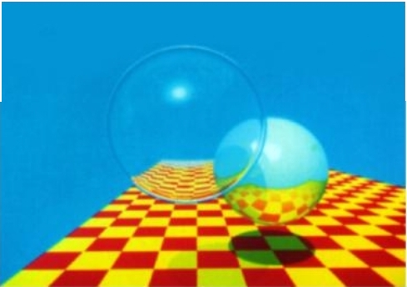
Classical Ray Tracing

Slide 7
Basic Idea
When we look at the screen our eyes see rays of light coming from the screen, the photons that come from the screen
Can be viewed as one ray per pixel, since pixels have constant colour
A ray that originates at the pixel and strikes the eye, contains information on one small part of the scene
But, how do we compute the pixel colour?

Slide 8
Basic Idea
We can just reverse the ray and trace (or follow) it into the scene
The ray goes from the pixel and then strikes an object in the scene, or continues on into the background
We now need to compute the colour of the object where the ray hits it
We need to determine the light contributions from other objects in the scene

Slide 9
Basic Idea
One thing that can contribute light is a light source
We can trace a ray from the intersection point to each of the light sources
If there is a clear path, we can compute the diffuse and specular light components produced by that light
If there isn’t a clear path, the object is in shadow from that light source, and only the ambient component is used

Slide 10
Basic Idea
The ray can also reflect off of the surface that it hit, using the exact reflection vector, an ideal mirror reflection
We can then follow this ray to see where it goes
If it strikes another object, we need to compute the colour at that object, this colour contributes to the colour of the original object
It becomes the reflected colour or highlight
Notice how this is becoming recursive

Slide 11
Basic Idea
If the object is transparent, we need to trace a ray through the object to find the colour on the other side
The ray can be refracted in this process, that is the path of the ray is bent
After it emerges from the object we keep on tracing the ray until it hits another object and we can compute the colour there
Note on exit the ray can be refracted a second time

Slide 12
Basic Idea
Each time a reflected or refracted ray hits another object we apply the ray tracing procedure recursively with the new ray starting at the intersection point
Thus, the original ray through the pixel can generate a large number of rays as it traces the light bouncing around the scene
We usually stop tracing once we have reached a certain level

Slide 13
Basic Idea
Light
Eye
Display
Screen

Slide 14
Basic Idea
Each of the original rays can generate many more rays
The original ray is called the primary ray, the other rays are secondary rays
We can view the collection of rays as a tree, with the pixel as the root
Each intersection forms a node, with the rays generated at that intersection leading to its children
This is called a ray tree, and can be recursively evaluated to produce the pixel colour

Slide 15
Basic Idea
Pixel
First Object
Light
Refracted
Reflected

Slide 16
Basic Idea
As you can see this tree can quickly grow quite large
Therefore, ray tracing can become quite expensive if we are not careful
We want to control the number of rays
We also want to make the intersection computations as efficient as possible since we need to do it a lot of times

Slide 17
Basic Idea
Returning to the question of when do we stop tracing rays, there are two possible termination conditions:
Stop tracing when the ray tree has reached a maximum height
Stop tracing when the contribution to the colour is below a certain level.
Usually both of these conditions are used, and we usually give the user control over them

Slide 18
Basic Idea
When we trace a ray we want to find the closest object, not just any object that the ray intersects
Only the closest object contributes, since the other objects are hidden by it
This solves the hidden surface problem for us
Naïve approach is to test every object in the scene, and then select the one with the closest hit, only works for very small scenes
Original approach used when there were only a few objects in the scene (less than 5)

Slide 19
Details
We have seen the big picture, the algorithm outline, now we need to explore the details
First we need to put everything in a common coordinate system so we can generate rays
We know that we need to generate a ray from the eye to each pixel on the screen, and then trace this ray into the scene or model, but what coordinate system is used?
There are two possible choices

Slide 20
Details
Viewing transforms assume that the eye is at the origin looking down the z axis
The display screen was perpendicular to the z axis
We can use this coordinate system for ray tracing, in this case we need to transform the model so it is in the eye coordinate system
We only need to do this once, so it is not a major efficiency concern

Slide 21
Details
A number of systems take the opposite approach
It places the eye and the display screen in the model coordinate system
A number of books develop the transformations required to convert the ray from the eye coordinate system to the model coordinate system
This transformation needs to be applied to each of the rays that go through the pixels
This is a very small part of the computation, so it has little impact on the rendering time

Slide 22
Intersection
This is the most expensive operation in ray tracing, so we need to be careful here
Mathematically we represent a ray in the following way:
p(t) = e + td, t > 0
Where e is the starting point of the ray, d is a unit vector in the ray direction and t is the parameter that gives the points on the ray
Note that t will always be greater than zero, otherwise the intersection is behind the eye

Slide 23
Intersection
One of the easiest objects to intersect is the sphere
Given the implicit representation of the sphere f(p) = 0 the intersection points can be computed by solving:
f(e+td) = 0
in vector form the equation of a sphere is:
(p-c)°(p-c) – R² = 0
Where c is the center and R is the radius

Slide 24
Intersection
On substituting into this equation we get:
(e+td – c)°(e+td – c) – R² = 0
Or
(d°d)t² +2d°(e-c)t + (e-c)°(e-c) – R² = 0
This is just a quadratic equation in t that can be written in the form:
At² + Bt + C = 0
The quadratic formula can be used to solve this equation
We know that there are two roots to this equation, if the roots are complex we know that the ray doesn’t hit the sphere

Slide 25
Intersection
Otherwise we have real roots, and we want the smaller of the two roots
The discriminant can be used to quickly check whether the roots are real, and only then do we proceed to computing the smallest root
Over the years many people have worked at optimizing this computation, performing the smallest number of calculations to get a result
Books on ray tracing contain these solutions, they are not worth repeating here, since they are far too detailed

Slide 26
Intersection
The sphere intersection calculation illustrates one of the main ray tracing techniques
If we have an implicit representation all we need to do is substitute the ray into this equation and solve
In the case of the sphere the solution is easy since we have an analytic solution for the roots
For other objects numeric solution techniques are required which can be quite slow

Slide 27
Intersection
For a general polygon the intersection calculation is a two step process
The first step determines where the ray intersects the polygon’s plane, as long as the ray isn’t parallel to the plane
The second step is determines whether the intersection point is inside or outside the polygon

Slide 28
Intersection
Given a polygon vertex p₁ and the normal n, to the polygon, the plane equation is given by:
(p – p₁)°n = 0
For any point p on the plane
Replacing p by e+td gives the following solution:
t = (p₁ – e)°n/(d°n)
If d°n = 0 the ray is parallel to the plane and there is no intersection
Again this is the first computation in the intersection procedure so we can quickly reject these polygons

Slide 29
Intersection
Now that we have the intersection point, how do we determine if it’s inside the polygon?
There is a simple test for this, we project the polygon and intersection point onto one of the coordinate planes, say the x - y plane
We then draw a line from the intersection point to infinity and count the number of times it intersects a polygon edge
If the count is odd, the point is inside the polygon

Slide 30
Intersection
Why does this work?
Each time the line intersects an edge it is either entering or leaving the polygon
If we have an even number of intersections, there must be an equal number of entering and leaving, so the original point must be outside
With an odd number we have entered more than we have left, so the original point must be inside the polygon
Note: this only works with convex polygons

Slide 31
Intersection
One good choice for a line is one parallel to the x axis, in this case the intersection calculation is easy
If one end point is above the line and the other is below, plus they are on the right side of the intersection point, then we have an intersection
Note, if the projection onto the x – y plane is a line, choose one of the other planes

Slide 32
Intersection
Since triangles are a common modeling primitive special techniques for intersecting them have been developed, books on ray tracing describe these techniques
Over the years intersection techniques for most of the common objects and modeling techniques have been produced
These techniques are not as efficient as the sphere and polygon techniques, so we need to be careful when we use them

Slide 33
Intersection
Intersection efficiency is a major concern in ray tracing, we have a lot of rays and they all must potentially be compared to all the objects in the scene
We need some way of making this more efficient
A key observation is that most of the objects won’t be hit by a particular ray, so we really want to perform non-intersection computations as quickly as possible
We only need to compute the intersection point in rare cases

Slide 34
Intersection
Most objects are quite complex, say many polygons, so if we could quickly eliminate them the computations would be quicker
In the case of objects that require numerical techniques for computing intersection points, quickly determining a non-intersection is a significant optimization
One way of doing this is to enclose them in a simpler shape
For example we could enclose them in a sphere, and then test for intersecting the sphere

Slide 35
Intersection
At this point we aren’t concerned with the actual intersection point, just whether an intersection is possible
Therefore we only need to determine if there are real roots
If the roots are complex, we go on to the next object, otherwise we need to examine the object in more detail to see if the ray intersects it

Slide 36
Intersection
Another possible enclosing shape is an axis aligned bounding box
This is a box with sides that are parallel to the coordinate planes, the normals to these sides are the coordinate axis
It is very easy to compute ray intersections with bounding boxes due to their simple structure, most books on ray tracing have the equations

Slide 37
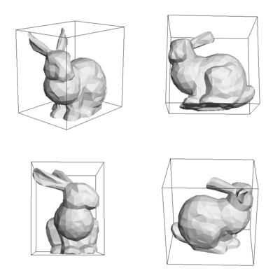
Bounding Volumes

Slide 38
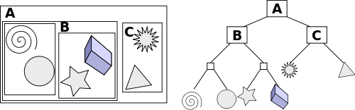
Bounding Volume Hierarchy

Slide 39
Intersection
If the ray intersects the bounding box or sphere then it could intersect the object inside, so we need to do more tests
Bounding boxes and bounding spheres work best when they are a tight fit for the object
If the ray intersects them there is a high probability it will intersect the object
Using this approach greatly increases the efficiency of a ray tracer

Slide 40
Intersection
Can we do better than this?
It turns out that we can, if we again make a simple observation
We want the closest intersection, the one closest to the start of the ray
It is more likely that this intersection will occur close to the start of the ray, not far away from it
Also the intersection will not occur behind the ray, and it won’t occur in a direction that the ray is not going

Slide 41
Intersection
In fact the ray really only passes through a very small part of the 3D space, it misses most of this space so we really don’t need to look there
So we need some way of organizing the objects in the scene so we only look at the ones where the ray will pass and ignore the rest of them
We want to test the objects in an intelligent order, the most likely ones first, but we need to make sure that we haven’t missed any closer ones

Slide 42
Intersection
One approach would be to sort the objects on distance, and the start checking the closest one first
This will work, but its very inefficient, since we would need to sort all of the objects for each ray
But this does hint at a solution
We can build a grid on top of the scene, and then assign the objects to the grid cells that they occupy
Each cell should hold a small number of objects, ideally 3 to 5

Slide 43
Intersection
We start the intersection testing at the cell where the ray starts
If it’s a pixel ray, we find the first cell that the ray hits
The objects in this cell are the closest ones to the ray origin, so if the ray hits one of them we are done
We can’t have a closer intersection, otherwise that object would be in the same cell
If we don’t have an intersection, we move to the next cell that the ray would travel through

Slide 44
Intersection
This approach only examines a small number of cells, if we have an n x n x n grid in the worst case it will examine 3^{1/2}n cells
If the objects are evenly distributed over the cells this results in a significant time savings, on the order of 1/n²
But in practice the objects are rarely evenly distributed
There are several problems with this approach
As we increase n to get more efficiency the data structure grows quite quickly, on the order of n³

Slide 45
Intersection
As the cell sizes get smaller its likely that an object will appear in many cells, and if we are not careful we will do the intersection computation multiple times
Many of the cells will be empty, so we will waste time tracing through them
Computing the next cell to visit takes time, and if they are empty we are wasting it
Thus there is a lower limit on the cell size, which limits the amount of speed up
Several techniques have been developed to improve grid performance

Slide 46
Intersection
Observation: we want the empty cells to be as large as possible so we can get through them quickly
We can do this by using an adaptive grid where the cell sizes can vary
This is a more complicated data structure and its implementation is not as efficient, but it can improve performance by reducing the number of empty cells

Slide 47
Shadows
Hard shadows are relatively easy to produce with ray tracing
In a hard shadow there is a sharp transition from the shadow to the illuminated region
We construct a ray for each light source, with the origin of the ray being the intersection point p
To get the ray direction we subtract p from the position of the light source and normalize
If the light source is infinitely far away we just use the light source direction as the ray direction

Slide 48
Shadows
We then determine if the ray intersects another object before it reaches the light source, if it does p is in shadow
What do we do if the ray hits the light?
Earlier we said that we used the standard 3 component light model
We already know that this is somewhat unrealistic, so it may not be the best choice, but are there alternatives?
Note that this only works for point light sources and ones that are infinitely far away

Slide 49
Reflections
For reflection we need to compute a reflection direction, this will be the direction of the new ray
The origin of the ray will be the intersection point p
To compute the reflection direction we need to direction of the original ray, d, and the surface normal, n
Our intersection computation should compute n as well so we can compute reflections

Slide 50
Reflection
The reflection direction r is computed in the following way:
r = d + 2(d°n)n
We then intersect this ray with the closest object, make sure that t > 0, so we don’t find the original intersection point
We then apply the ray tracing computation recursively to compute the colour of the point that the reflection ray hits

Slide 51
Reflection
What do we do with this colour?
The reflection basically contributes to the specular light component, so we multiply the reflected colour by the specular reflection coefficient
Since these coefficients are less than 1, each reflection contributes less to the overall value of the pixel, giving us a way to terminate the ray tracing
Accumulate product of specular reflection coefficients, once the product is below a threshold (say 0.01) we stop tracing reflected rays

Slide 52
Refraction
This is a bit more complicated than shadows and reflection
We can have objects the both reflect and refract light (are partially transparent), these objects are called dielectrics
Example of these objects include glass, water and even air
The next slide shows Snell’s law for refraction

Slide 53
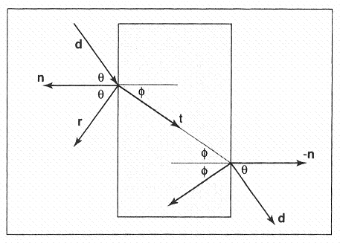
Refraction

Slide 54
Refraction
Snell’s law is given by:
n sinθ = n_{t} sinφ
Where n and n_{t} are the indices of refraction in the two media
It is usually easier to work with cos, so after some manipulation we get:

Slide 55
Refraction
This gives us an angle, but it doesn’t give us a direction vector
To get this we need to consider the geometry in the next slide
We can express our vector t in terms of two basis vectors b and n:
t = b sinφ - n cosφ
The problem is we need to find the vector b

Slide 56
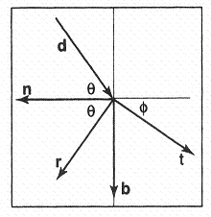
Refraction

Slide 57
Refraction
Since d lies in the same plane, we can use it to solve for b:
Putting this together gives:

Slide 58
Refraction
What happens if the term in the square root is negative?
In this case we have total internal reflection, the ray is not refracted and instead is reflected from the surface
If this occurs when the ray enters the material all the energy goes into reflection
If it occurs when the ray is leaving the material, there is no refracted light contribution

Slide 59
Refraction
We now have the rays, but what about the intensity of the reflected and refracted light?
The amount of reflection is a function of θ the incident angle, and is given by the Fresnel equations
These equations are not easy to solve, so we need to use an approximation that is reasonably efficient

Slide 60
Refraction
The Schlick approximation is reasonably accurate and is given by:
R(θ) could be multiplied by a specular reflection coefficient to give the total specular reflection from the surface

Slide 61
Refraction
As the light passes through the material it will be attenuated by it
Most materials are not as transparent as air and will have a greater effect on light transmission
Beer’s Law states that the attenuation of the light intensity, I, over an infinitesimal distance dx is given by:
dI = -CIdx

Slide 62
Refraction
This gives us the following differential equation:
dI/dx = -CI
The solution to this equation is:
To find the values of the constants we need to apply some initial conditions, which are I(0) = I₀ and I(1) = aI(0), where a is the attenuation constant

Slide 63
Refraction
Putting all of this together gives us the following result:
Where s is the distance that the ray has traveled through the material
One of the problems is that a is usually not known, so we usually need to guess at a values and do some trial and error experiments

Slide 64
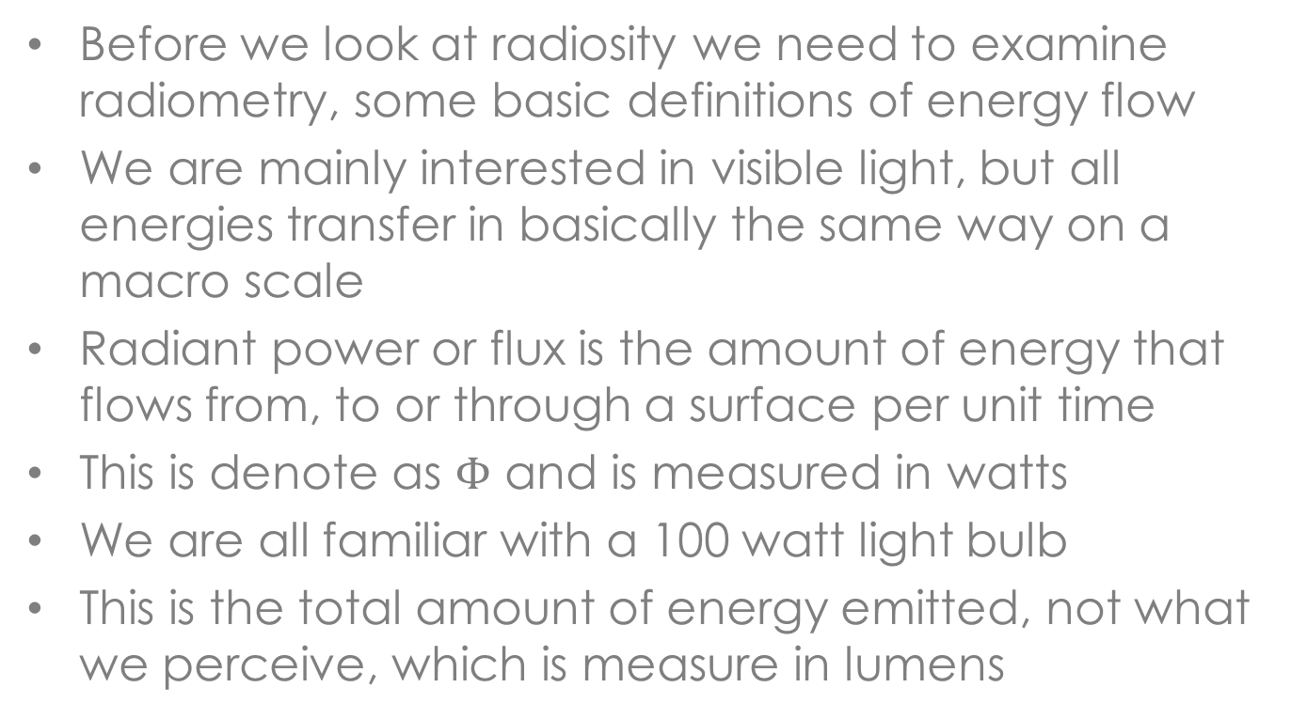
Radiometry
Before we look at radiosity we need to examine radiometry, some basic definitions of energy flow
We are mainly interested in visible light, but all energies transfer in basically the same way on a macro scale
Radiant power or flux is the amount of energy that flows from, to or through a surface per unit time
This is denote as $Φ$ and is measured in watts
We are all familiar with a 100 watt light bulb
This is the total amount of energy emitted, not what we perceive, which is measure in lumens

Slide 65
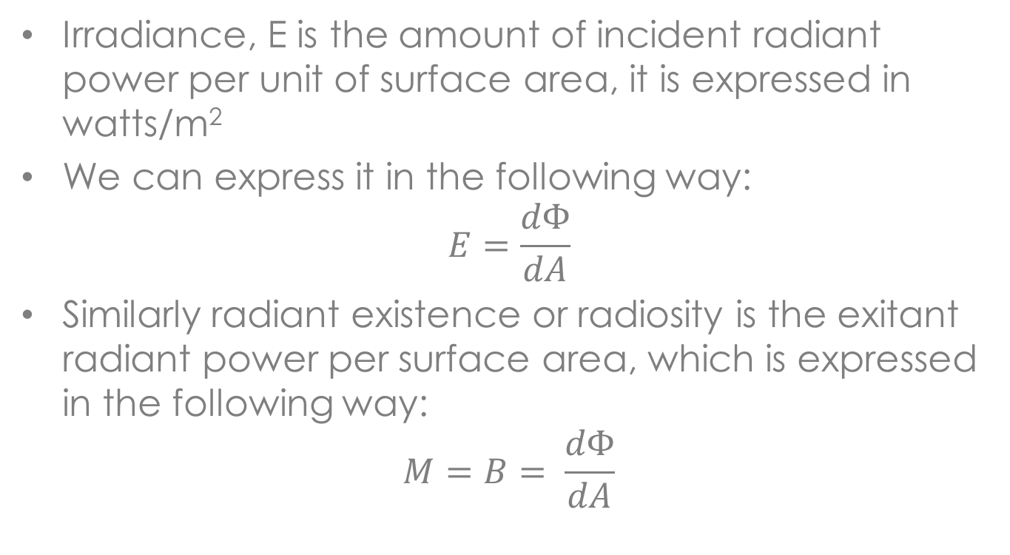
Radiometry
Irradiance, E is the amount of incident radiant power per unit of surface area, it is expressed in watts/m²
We can express it in the following way:
$$E=\frac{dΦ}{dA}$$
Similarly radiant existence or radiosity is the exitant radiant power per surface area, which is expressed in the following way:
$$M=B= \frac{dΦ}{dA}$$

Slide 66
Radiometry
Note that the expressions for E and B look the same, but they are measuring light transfer in opposite directions
E is incoming and B is outgoing energy, we will need both of them
When it comes to display radiosity is the important quantity because it is related to what we can see, the light energy that leaves a surface
All of these quantities are wavelength dependent, you should assume that there are at least R, G and B versions of them

Slide 67
Radiosity
There are many ways of deriving the classical radiosity equations
We can go back to first principles and work through all the light transfer equations, making the appropriate assumptions to get the equations
This is academically interesting, but no longer of much relevance to global illumination research
Start by assuming that we have a completely diffuse environment, only light sources and diffuse reflectors
Our light sources are area light sources

Slide 68
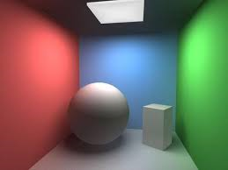
Radiosity

Slide 69
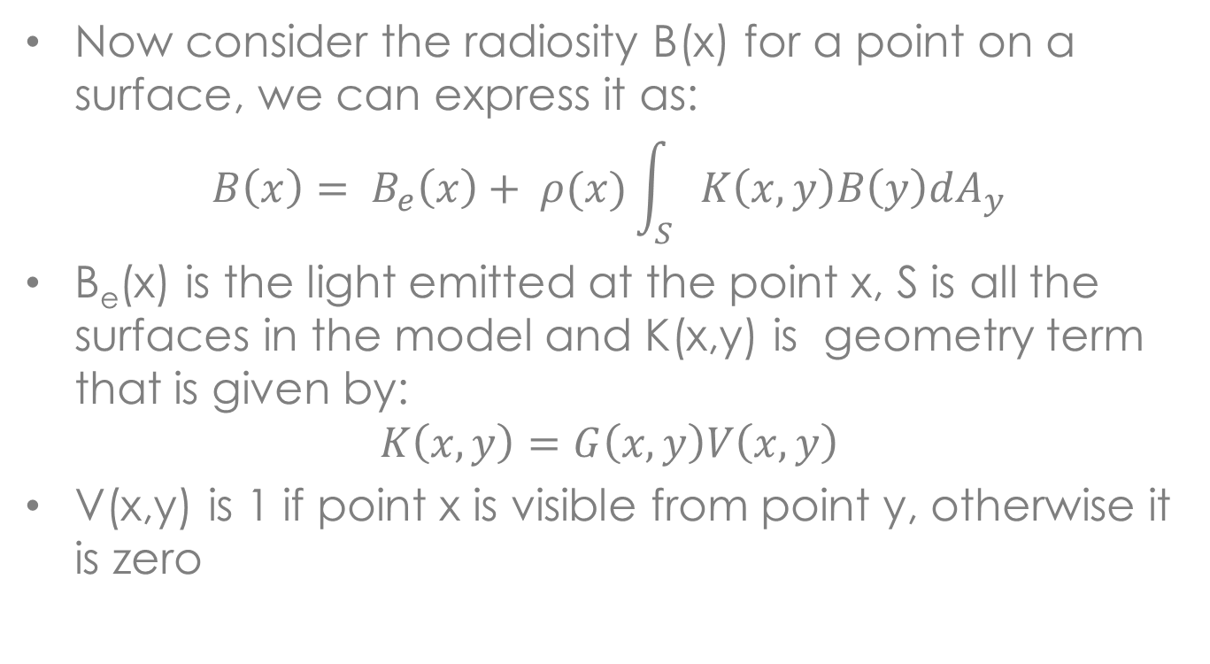
Radiosity
Now consider the radiosity B(x) for a point on a surface, we can express it as:
$$B\left(x\right)= B_{e}\left(x\right)+ ρ(x)\int_{S}{K\left(x,y\right)B\left(y\right)dA_{y}}$$
B_{e}(x) is the light emitted at the point x, S is all the surfaces in the model and K(x,y) is geometry term that is given by:
$$K\left(x,y\right)=G\left(x,y\right)V\left(x,y\right)$$
V(x,y) is 1 if point x is visible from point y, otherwise it is zero

Slide 70
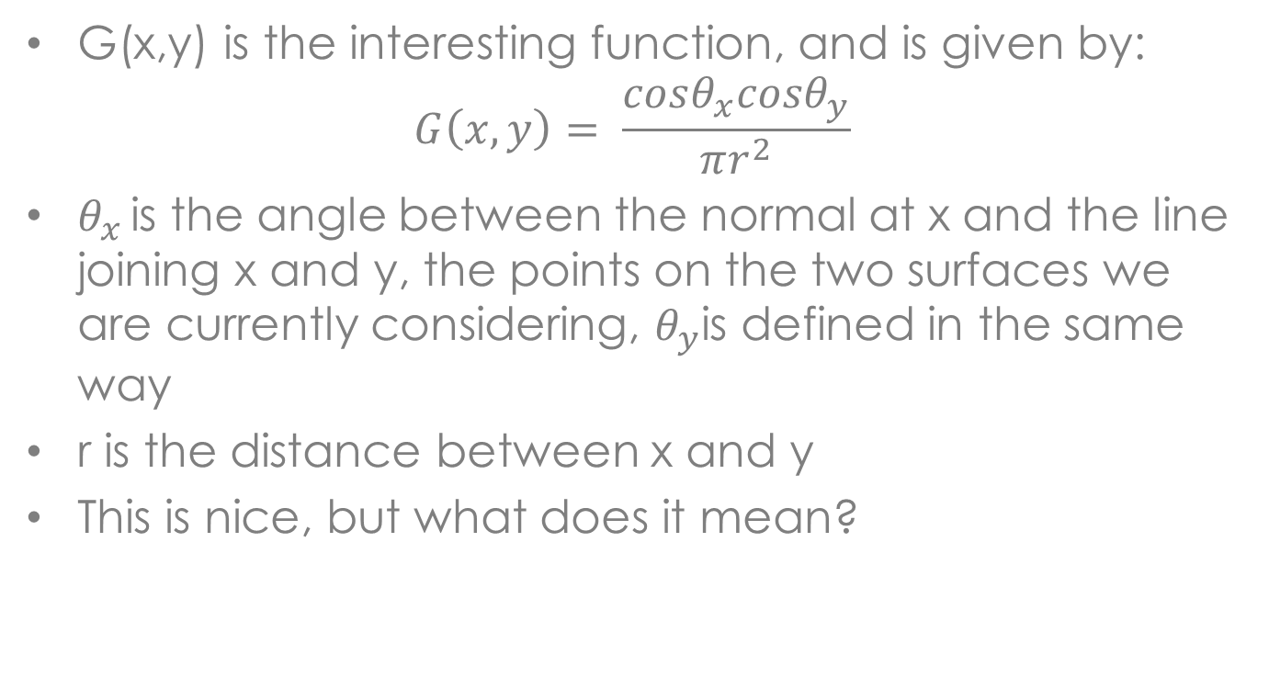
Radiosity
G(x,y) is the interesting function, and is given by:
$$G\left(x,y\right)= \frac{cosθ_{x}cosθ_{y}}{πr^{2}}$$
$θ_{x }$is the angle between the normal at x and the line joining x and y, the points on the two surfaces we are currently considering, $θ_{y}$is defined in the same way
r is the distance between x and y
This is nice, but what does it mean?

Slide 71
Radiosity
y
θ_{y}
N_{y}
N_{x}
θ_{x}
x

Slide 72
Radiosity
The radiosity at x is divided into two parts:
The amount of radiant energy emitted at point x, this would be the case if x was on a light source
The amount of light coming from all the other points in the scene that is then reflected at x
This equation is all in terms of differential properties, i.e. values at single points
This is hard to implement, we have modeling primitives with finite areas, we would like to have equations that deal with finite patches

Slide 73
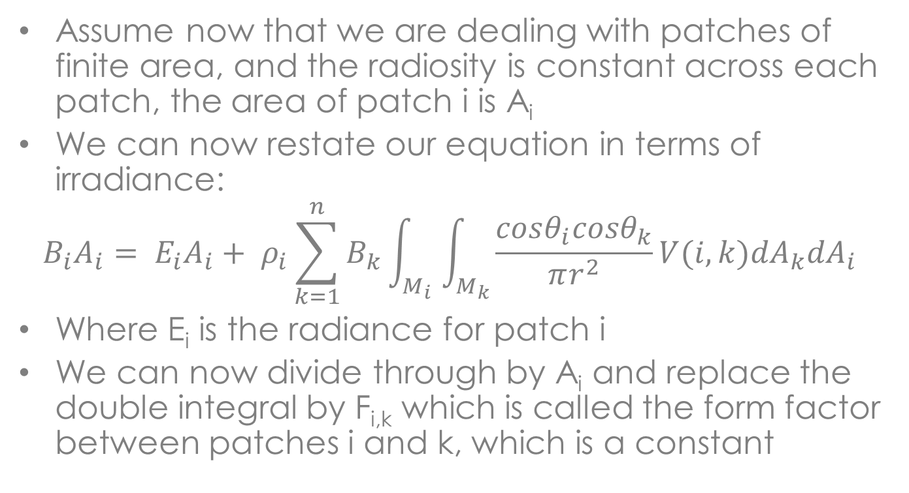
Radiosity
Assume now that we are dealing with patches of finite area, and the radiosity is constant across each patch, the area of patch i is A_{i}
We can now restate our equation in terms of irradiance:
$$B_{i}A_{i}= E_{i}A_{i}+ ρ_{i}\sum_{k=1}^{n}{B_{k}}\int_{M_{i}}{\int_{M_{k}}{\frac{cosθ_{i}cosθ_{k}}{πr^{2}}V(i,k){dA}_{k}{dA}_{i}}}$$
Where E_{i} is the radiance for patch i
We can now divide through by A_{i} and replace the double integral by F_{i,k} which is called the form factor between patches i and k, which is a constant

Slide 74
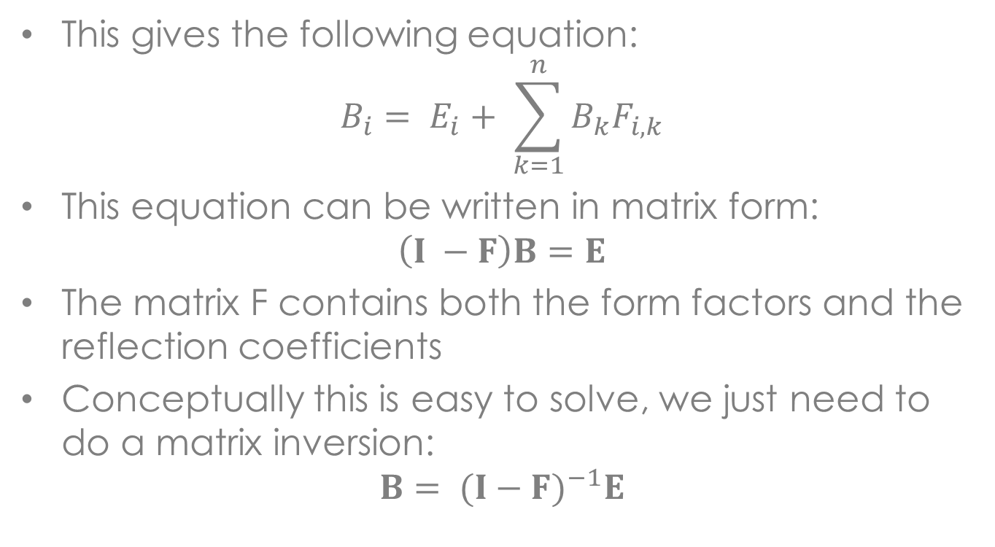
Radiosity
This gives the following equation:
$$B_{i}= E_{i}+ \sum_{k=1}^{n}{B_{k}F_{i,k}}$$
This equation can be written in matrix form:
$$\left(I −F\right)B=E$$
The matrix F contains both the form factors and the reflection coefficients
Conceptually this is easy to solve, we just need to do a matrix inversion:
$$B= {(I−F)}^{−1}E$$

Slide 75
Radiosity
There are two problems here:
n is very large, so the matrix will be large making solutions difficult
Where do the form factors come from?
We will tackle the first problem first
To simplify things we will write K = (I – F)
So our equation becomes:
KB = E
In this equation K is an nxn matrix and both B and E are nx1 vectors

Slide 76
Radiosity
The problem is that n can be quite large, usually on the order of several thousand
Thus our matrix is quite large and inverting it is quite expensive, so numerical inversion is out of the question
Luckily our matrix is very well behaved so we can use iterative techniques that are much more efficient
These techniques also suggest some interesting global illumination algorithms

Slide 77
Radiosity
We can rewrite our equation in the following way:
0 = E – KB
We can start with an estimate of B and see if it is close enough, if not we will improve this estimate
We will call this estimate X, and use it to compute a residual r:
r = E – KX
The equation is solved when r is zero, so the aim of the iterative algorithm is to reduce the value of r
We can use a greedy strategy where we minimize each of the x_{i} individually

Slide 78
Radiosity
We can do this using the following computation:
x_{i} = x_{i} + r_{i}/K_{i,i}
While this will drive r_{i} to zero, it could increase the value of other entries of r
The hope is that as we keep iterating the solution will converge, and with our matrix this is guaranteed to occur
What we have just covered is the basis of the Jacobi algorithm, which is outlined on the next slide

Slide 79
Jacobi Algorithm
for i = 0 to n
X_{i} = 0
while not converged
r = E – KX
for i = 0 to n
x_{i} = x_{i} + r_{i}/K_{i,i}

Slide 80
Radiosity
We can do better if we initialize X to E instead of zero, this basically sets the lights to the radiosity they are emitting instead of zero
At the end of each iteration of the while loop we have an estimate of the complete solution
The sum of the elements in the residual is the amount of energy left in the system that hasn’t been distributed to patches, this is called the unshot energy
In computing the new value of x_{i} we are using old values of x_{j}, some of which have been updated

Slide 81
Radiosity
The basic idea behind the Gauss-Seidel algorithm is to use the most recently computed values in X instead of using the ones from the previous iteration
The algorithm is on the next slide
This is an example of a gathering algorithm, we go to all the other patches in the environment and sum their radiosity times their form factors to produce the radiosity contribution
That is, we gather the energy for the other patches and add it to the current patch

Slide 82

Gauss-Seidel Algorithm
for i = 0 to n
x_{i} = 0
While not converged
for i = 0 to n
$x_{i}=(e_{i} − \sum_{k=1,i≠k}^{n}{x_{k}K_{i,k}})/K_{i,i}$

Slide 83
Radiosity
We can make a significant improvement to the algorithm with a simple observation, we should concentrate on the largest residuals first
This is the largest amount of unshot energy, usually the light sources
Should we concentrate on this first?
This is the main idea behind the Southwell algorithm
We want to find the x_{i} with the largest residual, process it the same as the Gauss-Seidel algorithm and then update the residuals
But this sounds expensive, since the residual computation is expensive

Slide 84
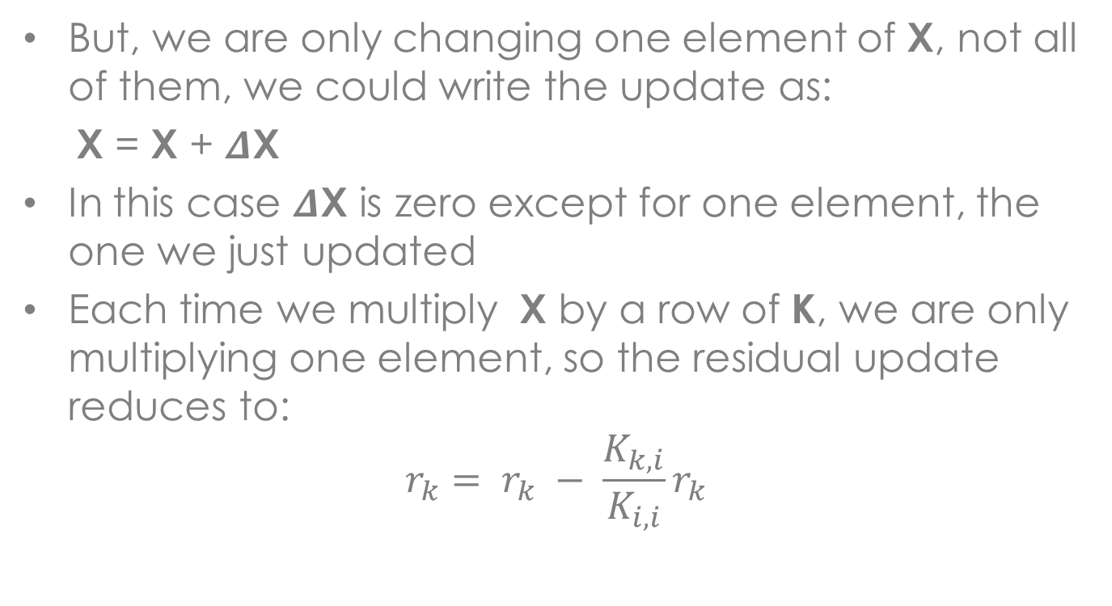
Radiosity
But, we are only changing one element of X, not all of them, we could write the update as:
X = X + $Δ$X
In this case $Δ$X is zero except for one element, the one we just updated
Each time we multiply X by a row of K, we are only multiplying one element, so the residual update reduces to:
$$r_{k}= r_{k} − \frac{K_{k,i}}{K_{i,i}}r_{k}$$

Slide 85
Southwell Algorithm
for i = 0 to n
x_{i} = 0
r_{i} = e_{i}
while not converged
select i such that r_{i} = max(r)
x_{i} = x_{i} + r_{i}/K_{i,i}
t = r_{i}
for k = 0 to n
r_{k} = r_{k} – t(K_{k,i}/K_{i,i})

Slide 86
Radiosity
The Southwell algorithm is an example of a shooting algorithm
We take the excess energy at patch i and shoot it out to all the other patches
Note, there may be patches that we don’t shoot energy from, their light level may be too low to notice
The solution may converge before we need to process some of these patches
This can be a major time savings over the other algorithms that process all of the patches

Slide 87
Radiosity
We may not need all of the form factors, they may never be needed in the computation
We don’t need to compute the K matrix, we can compute the form factors on demand as they are required
This is a considerable savings in time and space, since we don’t need to store the K matrix
Usually form factors are cached, in case they are needed again, but this can be a relatively small number of form factors

Slide 88
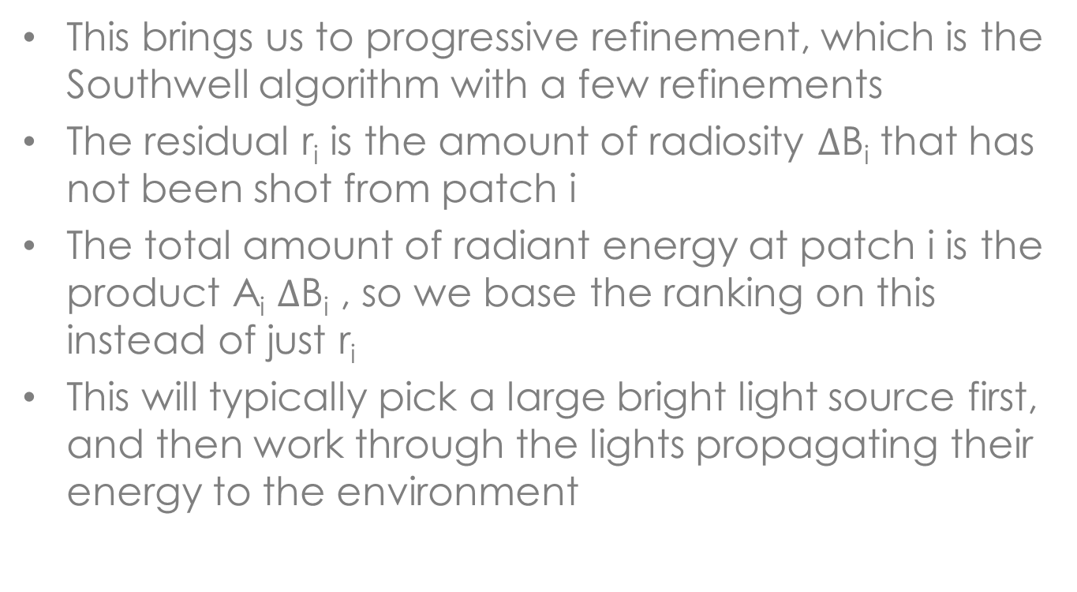
Radiosity
This brings us to progressive refinement, which is the Southwell algorithm with a few refinements
The residual r_{i} is the amount of radiosity $Δ$B_{i} that has not been shot from patch i
The total amount of radiant energy at patch i is the product A_{i} $Δ$B_{i} , so we base the ranking on this instead of just r_{i}
This will typically pick a large bright light source first, and then work through the lights propagating their energy to the environment

Slide 89
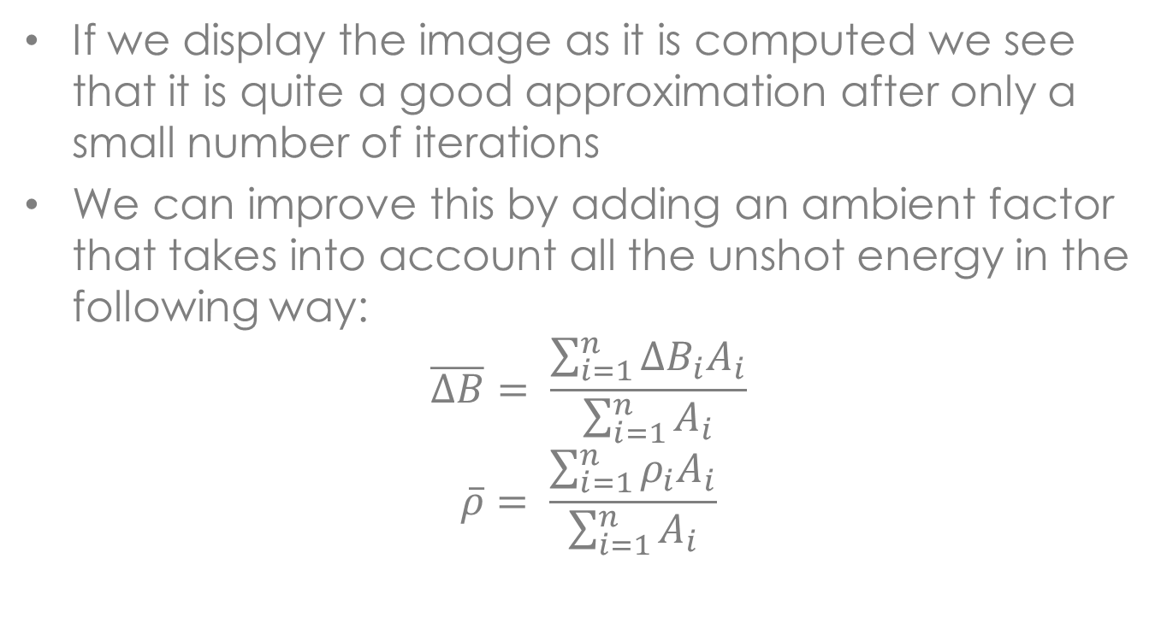
Radiosity
If we display the image as it is computed we see that it is quite a good approximation after only a small number of iterations
We can improve this by adding an ambient factor that takes into account all the unshot energy in the following way:
$$\overline{ΔB}= \frac{\sum_{i=1}^{n}{{ΔB}_{i}A_{i}}}{\sum_{i=1}^{n}{A_{i}}}$$
$$\overline{ρ}= \frac{\sum_{i=1}^{n}{ρ_{i}A_{i}}}{\sum_{i=1}^{n}{A_{i}}}$$

Slide 90
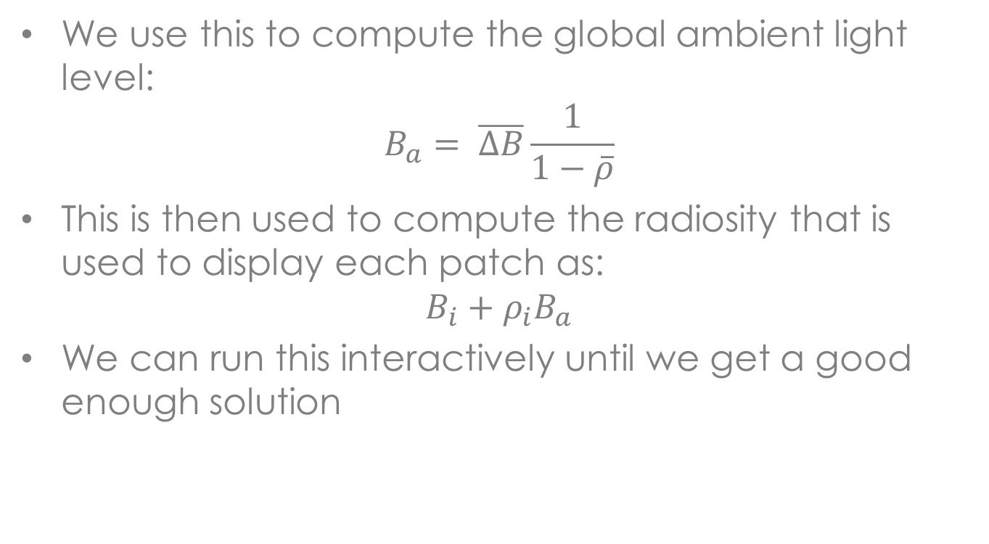
Radiosity
We use this to compute the global ambient light level:
$$B_{a}= \overline{ΔB}\frac{1}{1−\overline{ρ}}$$
This is then used to compute the radiosity that is used to display each patch as:
$$B_{i}+ρ_{i}B_{a}$$
We can run this interactively until we get a good enough solution

Slide 91
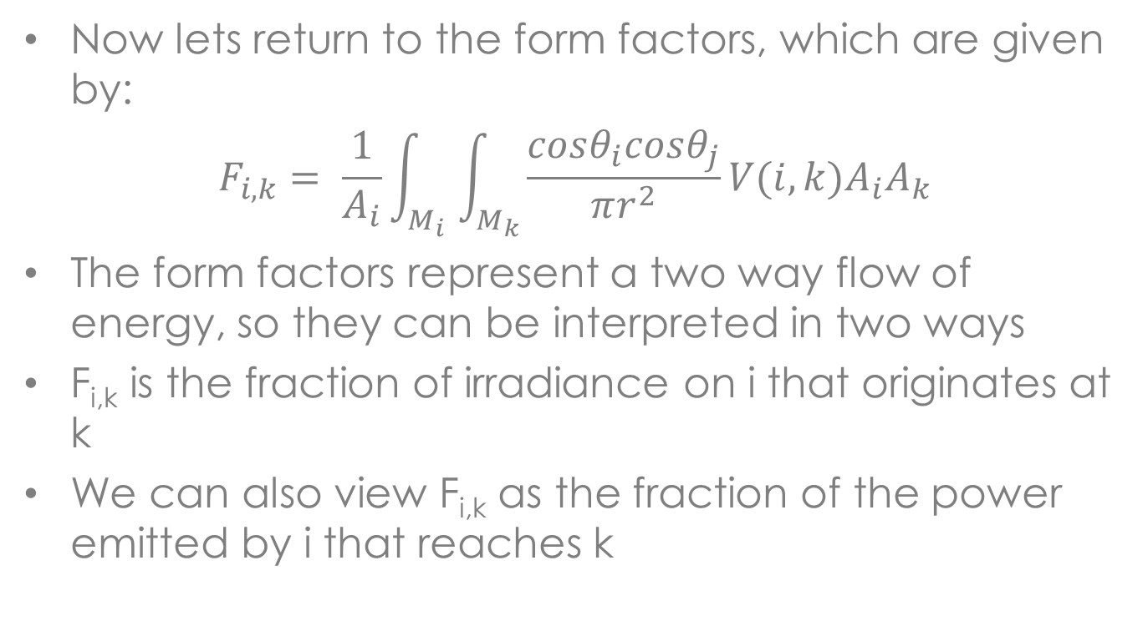
Radiosity
Now lets return to the form factors, which are given by:
$$F_{i,k}= \frac{1}{A_{i}}\int_{M_{i}}{\int_{M_{k}}{\frac{cosθ_{i}cosθ_{j}}{πr^{2}}V(i,k)A_{i}A_{k}}}$$
The form factors represent a two way flow of energy, so they can be interpreted in two ways
F_{i,k} is the fraction of irradiance on i that originates at k
We can also view F_{i,k} as the fraction of the power emitted by i that reaches k

Slide 92
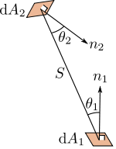
Radiosity

Slide 93
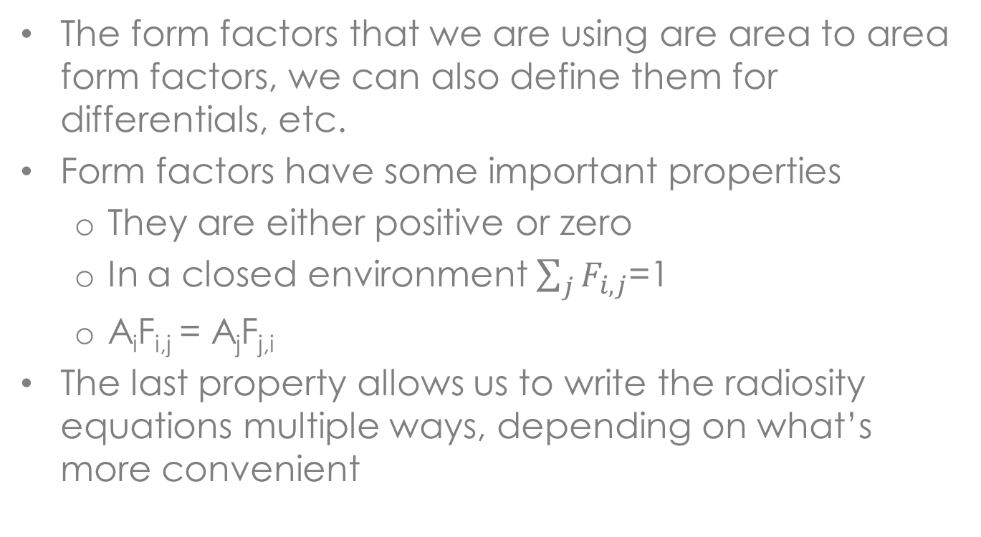
Radiosity
The form factors that we are using are area to area form factors, we can also define them for differentials, etc.
Form factors have some important properties
They are either positive or zero
In a closed environment $\sum_{j}{F_{i,j}}$=1
A_{i}F_{i,j} = A_{j}F_{j,i}
The last property allows us to write the radiosity equations multiple ways, depending on what’s more convenient

Slide 94
Radiosity
How do we compute form factors?
In some cases we can compute them analytically
In some cases we can decompose a shape into simpler pieces that have analytical solutions, if the pieces don’t overlap we can sum their form factors
Most of the time we need to use a numerical technique
The most difficult part of the equation is V(i,k) the other part of the integral is rather easy to evaluate

Slide 95
Radiosity
The standard way to compute form factors is to use the hemicube algorithm
This is based on constructing 5 images centered on patch i similar to what we did with environment mapping
We run a standard z-buffer algorithm with the camera at the center of patch i for each of the 5 surfaces
Instead of storing the colour in the frame buffer we store j the index of the closest patch, this gives us the value of V(i,j) for each direction above the patch

Slide 96
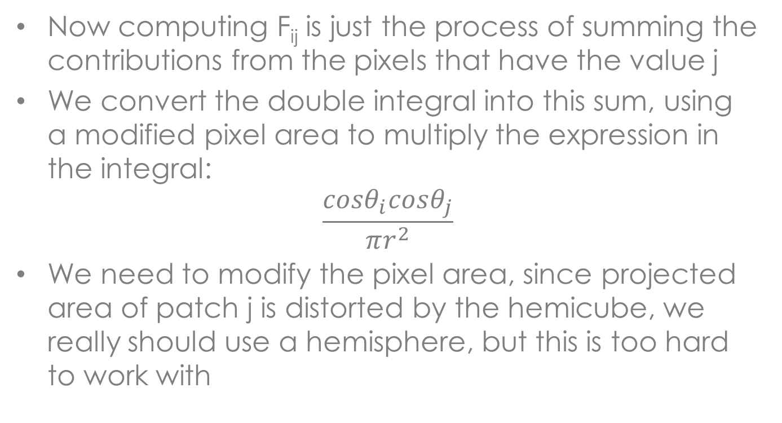
Radiosity
Now computing F_{ij} is just the process of summing the contributions from the pixels that have the value j
We convert the double integral into this sum, using a modified pixel area to multiply the expression in the integral:
$$\frac{cosθ_{i}cosθ_{j}}{πr^{2}}$$
We need to modify the pixel area, since projected area of patch j is distorted by the hemicube, we really should use a hemisphere, but this is too hard to work with

Slide 97
Radiosity
With modern graphics hardware form factors can be computed quite quickly, they are even algorithms for the GPU
Note when using a hemicube you can get into all of the aliasing problems that can occur with the z-buffer algorithm
Also since the camera is positioned on the centre of the patch we assume that the quantities don’t change much over the surface of the patch

Slide 98
Radiosity
We now have our radiosity values, but how do we display them?
We could use the radiosity value as the constant colour for the patch, but this makes our images look blocky
Instead the colours are pushed to the vertices, the vertex colour is the average of the patches that are adjacent to the vertex
Then standard shading technique can be used to display the image

Slide 99
Summary
Ray tracing and radiosity solve two sides of the global illumination problem
Ray tracing does an good job of specular reflection, but ignores diffuse reflection
Radiosity does a good job of diffuse reflection, but can’t handle specular reflection
We need some way of combining the two techniques to produce a general global illumination technique

